Slide 1
Automating Bespoke Attack
Chapter 13
Ruei-Jiun

Slide 2
Outline
Uses of bespoke automation
Enumerating identifiers
Harvesting data
Web application fuzzing
JAttack
a simple bespoke automation tool based on Java
Burp Intruder (an intruder tool in Burp Suite)

Slide 3
Why automating bespoke attacks?
Performing bespoke attacks manually can be extremely laborious and is prone to mistakes
The use of automation strengthen and accelerate bespoke attacks
Notes:
one key element in an effective methodology for hacking web applications — that is, the use of automation to strengthen and accelerate bespoke attacks
Performing bespoke attacks manually can be extremely laborious and is prone to mistakes

Slide 4
Uses for Bespoke Automation
There are three main situations in which bespoke automated techniques can be employed to assist you in attacking a web application
Enumerating identifiers
Harvesting data
Web application fuzzing

Slide 5
Detecting Hits
There are numerous attributes of responses in which systematic variations may be detected, and which may provide the basis for an automated attack
HTTP Status Code
Response Length
Response Body
Location Header
Set-Cookie Header
Time Delays

Slide 6
HTTP Status Code
200 – The default response code, meaning “ok.”
301 or 302 – A redirection to a different URL.
401 or 403 – The request was not authorized or allowed.
404 – The requested resource was not found.
500 – The server encountered an error when processing the request.

Slide 7
Response Length
Dynamic application pages construct responses using a page template which has a fixed length and insert per-response content into template
If the per-response content does not exist or is invalid, the application might return an empty template
Different response lengths may point towards the occurrence of an error or the existence of additional functionality
Notes:
In the authors’ experience, the HTTP status code and response length indicators have been found to provide a highly reliable means of identifying anomalous responses in the majority of cases.

Slide 8
Response Body
It is common for the returned data to contain literal strings or patterns such as not found, error, exception, illegal, invalid, that can be used to detect hits

Slide 9
Location Header
In some cases, the application will respond to every request for a particular URL with an HTTP redirect
The target of HTTP redirect is specified in the Location header
correct
.../download.jsp
Request Parameters
incorrect
.../error.jsp

Slide 10
Time Delays
The time taken to return the response may differ between valid and invalid parameters are submitted
When an invalid username is submitted, the application may respond immediately
However, when a valid username is submitted, the application may perform some computationally intensive validation of supplied credentials

Slide 11
Enumerating Valid Identifiers
Various kinds of name and identifiers are used to refer to individual items of data and resources
Such as account no., usernames, document IDs
https://wahh-app.com/app/showPage.jsp?PageNo=244197
As an attacker your task is to discover some or all of the valid identifiers in use.
Notes:
You can use automation in a fully bespoke way to work through a list of possible identifiers or cycle through the syntactic range of identifiers believed to be in use of the application

Slide 12
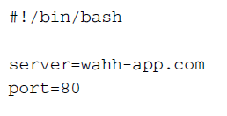
Enumerating Valid Identifiers -Scripting the Attack
http://wahh-app.com/ShowDoc.jsp?docID=3801
Notes:
Let’s suppose that we have identified the following URL, which returns a 200 response code when a valid docID value is submitted, and a 500 response code
otherwise:

Slide 13
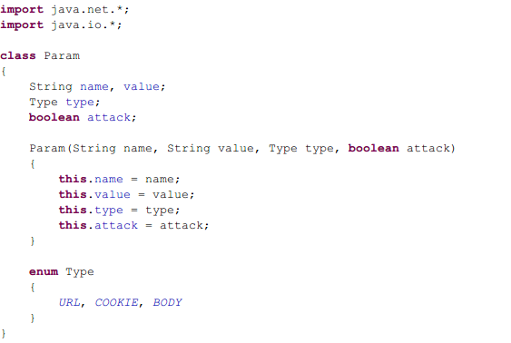
Enumerating identifiers - JAttack
Request parameter class
- hold parameter details
- can be manipulated
- attached to a request

Slide 14
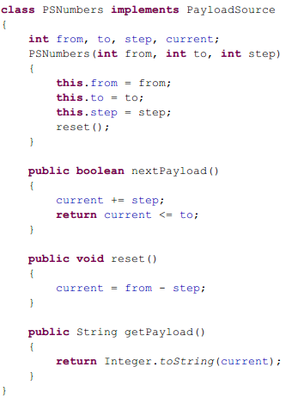
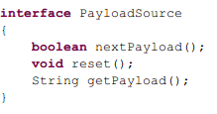
Enumerating identifiers - JAttack

Slide 15
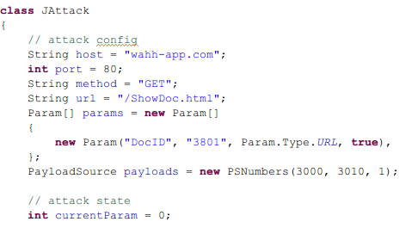
Enumerating identifiers - JAttack
Specify URL details

Slide 16
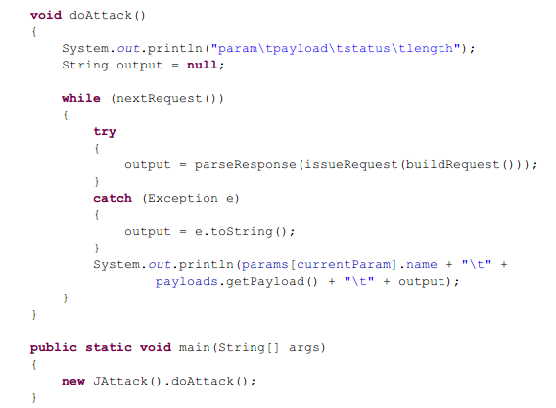
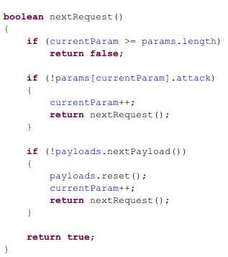
Enumerating identifiers - JAttack

Slide 17
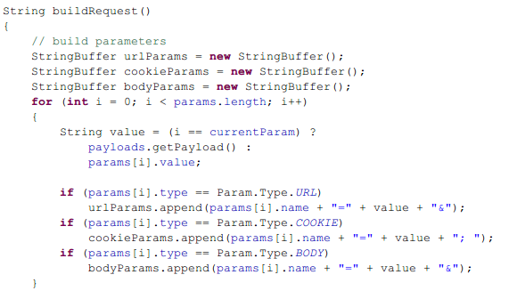
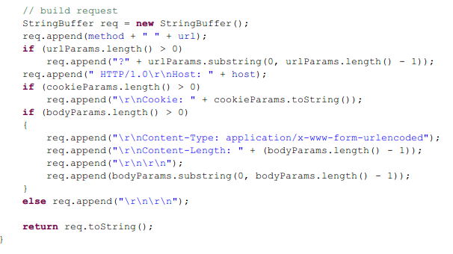
Enumerating identifiers - JAttack

Slide 18
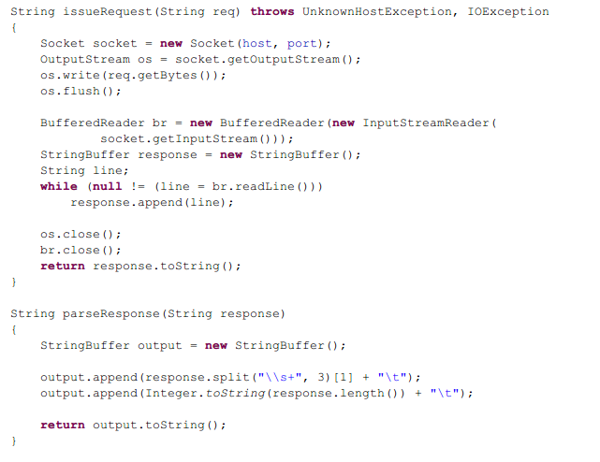
Enumerating identifiers - JAttack

Slide 19
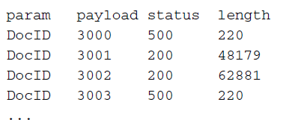
Enumerating identifiers - JAttack
Compile and run Jattack
Outout
Notes:
JAttack is capable of issuing hundreds of individual requests per minute and outputting the pertinent details, enabling you to very quickly identify valid
document identifiers for further investigation

Slide 20
Harvesting Data
There are many vulnerabilities that enables you to extract useful data from web applications
For example, a personal profile page may display the personal and banking details of the current user and indicate that user’s privilege level within the application
Notes:
Through an access control defect, you may be able to view the personal profile page of any application user —but only one user at a time. To harvest this data for every user might require thousands of individual requests.
Rather than working manually, you can use a bespoke automated attack to quickly capture all of this data in a useful form.
Not only interested in a binary result (a hit or miss), but are seeking to extract some of the content of each response in a useable form

Slide 21
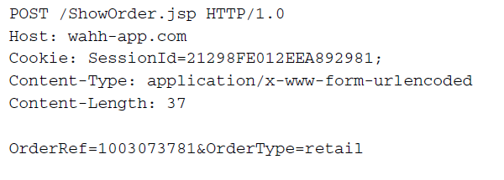
Harvesting Data
Consider this request used by an online retailer, which displays the details of a specific order
Assume there is an access control vulnerability that any user can view the details of any order

Slide 22
Harvesting Data
The format of parameter OrderRef :
6-digit date + 4-digit number
When the details for an order are displayed, the page source contains the personal data within an HTML table like the following

Slide 23
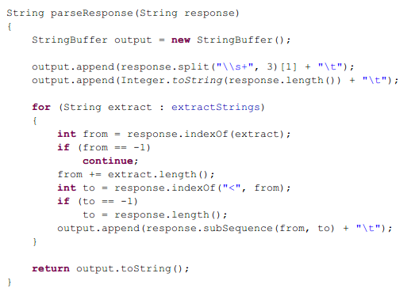
Harvesting Data -JAttack
Modify the response parsing to search the response and extract what we want

Slide 24
Harvesting Data -JAttack
Configure the request to what we are interested

Slide 25
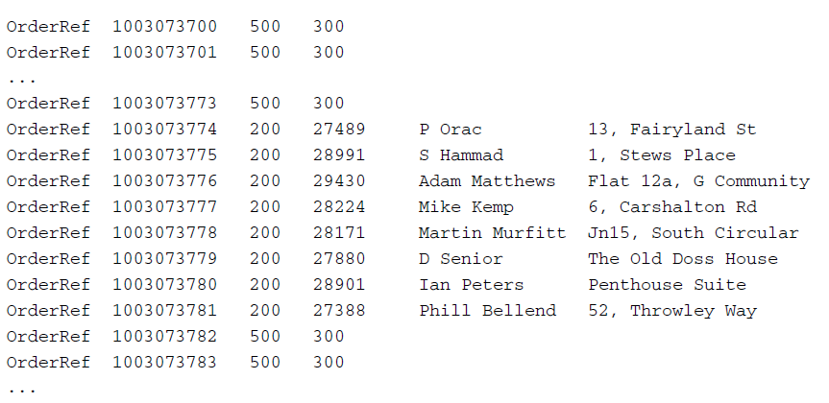
Harvesting Data -JAttack
Output

Slide 26
Web Application Fuzzing
Using bespoke automation, you can quickly generate huge numbers of requests containing common attack strings, and quickly assess the server’s responses. This technique is often referred to as fuzzing.
Various attack strings designed to cause anomalous behavior are submitted to see if particular common vulnerabilities are exist
Notes:
review the application’s responses for any anomalies that indicate that the flaw may be present.
quickly generate huge numbers of requests containing common attack strings, and quickly assess the server’s responses to home in on interesting cases that merit
further investigation. This technique is often referred to as fuzzing.

Slide 27
Web Application Fuzzing
Consider the example request

Slide 28
Web Application Fuzzing
‘ — This will generate an error in some instances of SQL injection.
;/bin/ls — This string will cause unexpected behavior in some cases of command injection.
../../../../../etc/passwd — This string will cause a different response in some cases where a path traversal flaw exists.
xsstest — If this string is copied into the server’s response then the application may be vulnerable to cross-site scripting.

Slide 29
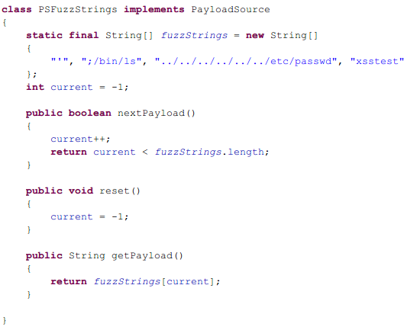
Web Application Fuzzing - JAttack
Implement new payload containing fuzz strings

Slide 30
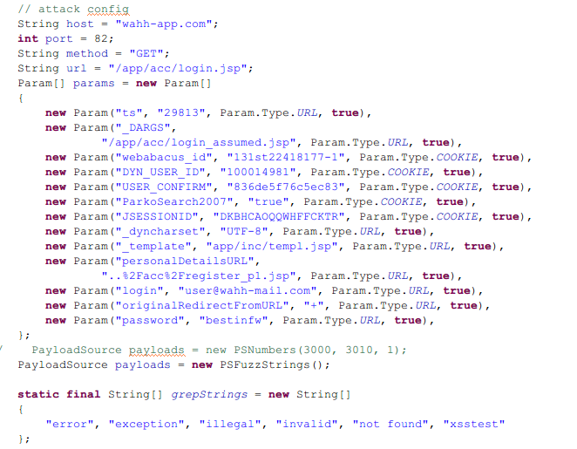
Web Application Fuzzing - JAttack
Configure request details

Slide 31
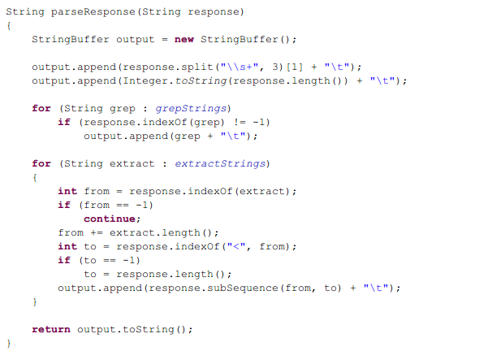
Web Application Fuzzing - JAttack
Modify response parsing

Slide 32
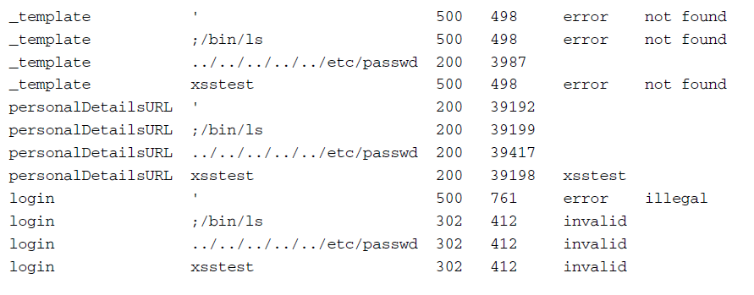
Web Application Fuzzing - JAttack
Output

Slide 33
Burp Intruder
A unique tool that implements all the functionality that we described
Enable us to perform all kinds of bespoke automated attacks with a minimum of configuration
Fully integrated with the other Burp Suite tools like proxy and spider

Slide 34
Burp Intruder
3 Steps:
Positioning payloads
Choosing payloads
Configuring Response Analysis

Slide 35
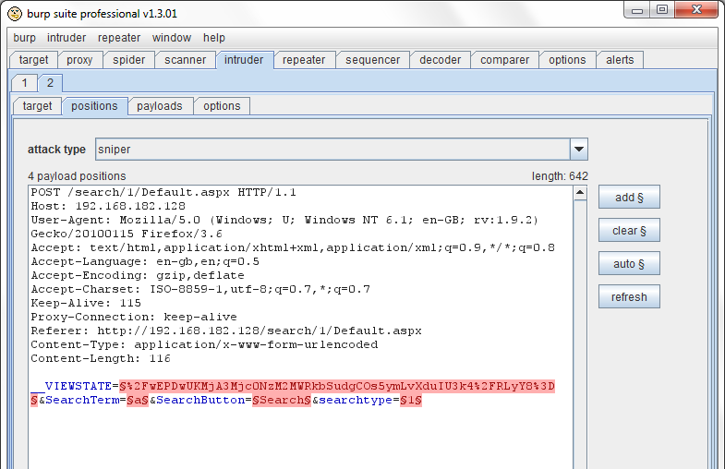
Burp Intruder
1. Positioning payloads

Slide 36
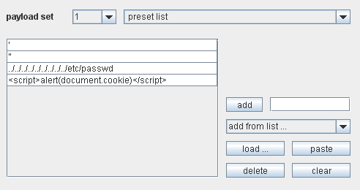
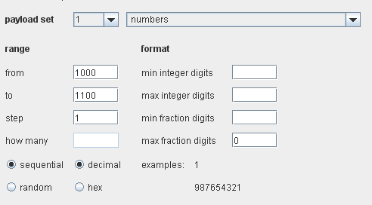
Burp Intruder
2. Choosing payloads

Slide 37
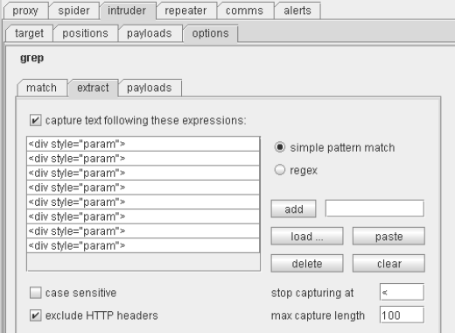
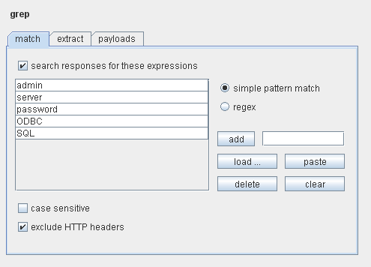
Burp Intruder
3. Configuring Response Analysis

Slide 38
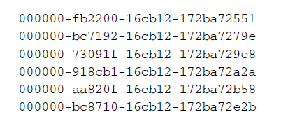
Burp Intruder – Enumerating Identifiers
Consider the following session tokens that you logged in for several times to get
Modifying second potion of the tokens does not invalidate the tokens

Slide 39
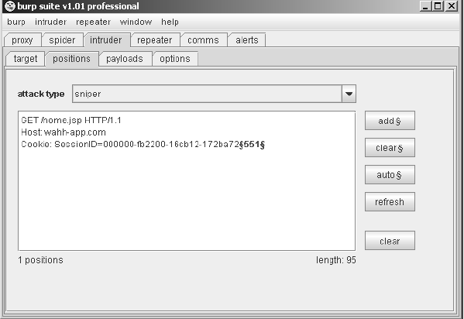
Burp Intruder – Enumerating Identifiers
1. Configure the payload position

Slide 40
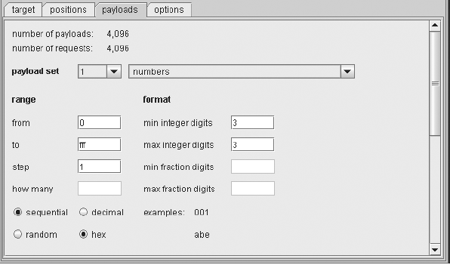
Burp Intruder – Enumerating Identifiers
2. Configure the payload source to generate hexadecimal numbers

Slide 41
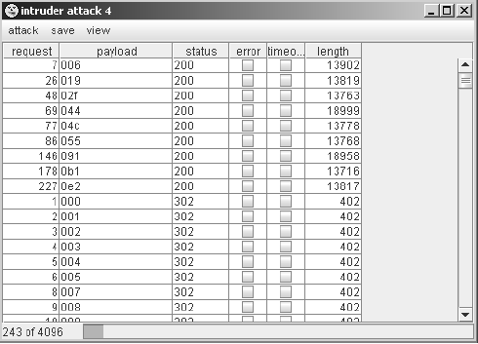
Burp Intruder – Enumerating Identifiers
3. Launch the attack to see the results

Slide 42
Burp Intruder – Harvesting Data
Suppose you found that you have access to a logging function using the more privileged session token, and log file entries are accessed using the following request

Slide 43
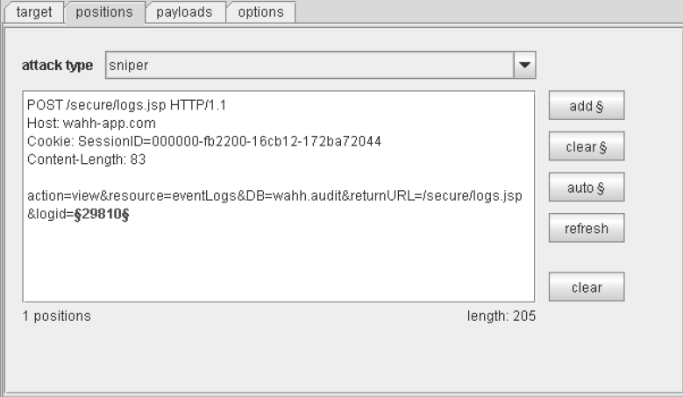
Burp Intruder – Harvesting Data
1. Use a numeric payload source to generate integers within the range of identifiers

Slide 44
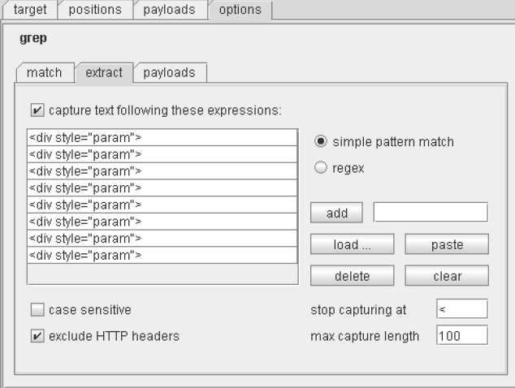
Burp Intruder – Harvesting Data
2. Configure Intruder to capture information in a usable form

Slide 45
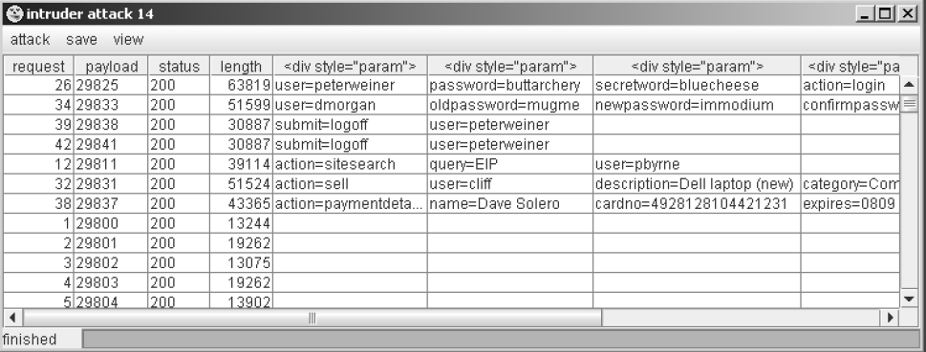
Burp Intruder – Harvesting Data
Result

Slide 46
Burp Intruder – Fussing
Functionality that can be reached only by privileged users is often less secure because it is assumed that only trusted users will access it

Slide 47
Burp Intruder – Fussing

Slide 48
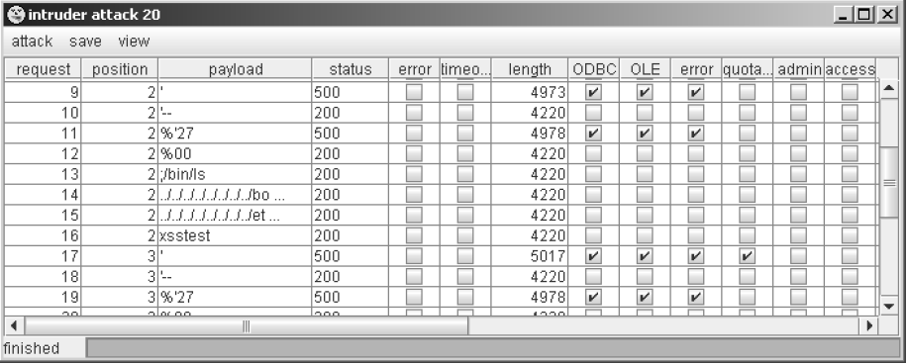
Burp Intruder – Fussing
Result

Slide 49
Summary
It is possible to automate virtually any manual procedure to use the power and reliability of the computer to attack
Using bespoke automation in an effective way requires experience, skill, and imagination
Tools will help you

