Slide 1
Data Structures Lecture 1
Fall 2011
Fang Yu
Department of Management Information Systems
National Chengchi University

Slide 2
A brief review of Java programming

Slide 3
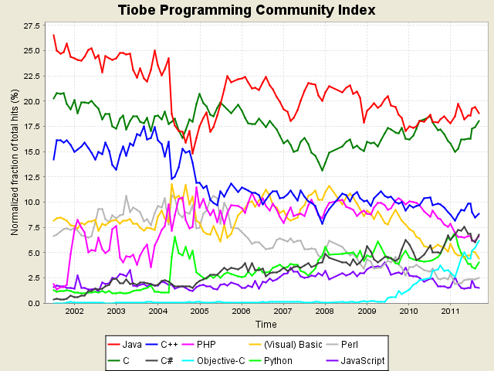
Popularity of Programing Languages

Slide 4
About Java
Java is
the most popular language in the past years: http://www.tiobe.com/index.php/content/paperinfo/tpci/index.html
Simple, object-oriented, distributed, interpreted, robust, secure, architecture-neutral, portable, multi-threaded, dynamic, and more.
Classes, Types, and Objects
An object is the basic unit in Java
A class defines the type of an object

Slide 5
Java Programming Basics
A class consists of
fields (to store data)
methods (to define operations that can act on data)
The class name (this code must save as Hello.java)
A field
public class Hello {
public static int var;
public static void say(String s) {
System.out.print(“Hello ”+s);
}
public static void main(String[] argv) {
say(”World!");
}
}
A method
The main method (The entry point while executing the program)

Slide 6
Modifiers
“public” indicates that anyone can run/extend/import this class
“static” indicates the field/method belongs to the class, not objects
public class Hello {
public static int var;
public static void say(String s) {
System.out.print(“Hello ”+s);
}
public static void main(String[] argv) {
say(”World!");
}
}
“void” indicates that the method returns nothing

Slide 7
How Java works
Compile
Interpret
Java source
code
Java
bytecode
result
Hello.java
Hello.class
Java Virtual Machine
Execute your code on command line
“javac Hello.java” to generate Hello.class
“java Hello” to execute the bytecode

Slide 8
Example: Operator
Operators are similar to C++
E.g., =, +, - , *, /, %
A simple example:
Sum 1 to 100 using a formula
javac Example.java
java Example
1+2+...+100 = 5050
public class Example {
public static void main(String[] argv) {
int n = 100;
System.out.println("1+2+...+"+n+" = " + ( n * (n + 1) / 2));
}
}

Slide 9
Example: Loop
Sum 1 to 100 using a method with for-loop
public class Example {
public static int sum(int n) {
int total = 0;
for (int i = 1; i <= n; i++) { total += i; }
return total;
}
public static void main(String[] argv) {
int n = 100;
System.out.println("1+2+...+"+n+" = " + sum(n));
}
}
javac Example.java
java Example
1+2+...+100 = 5050

Slide 10
Use pre-defined class library
Use java.util.Scanner for getting inputs
The Scanner class reads the input stream and divides it into tokens by delimiters (whitespace)
The Scanner class includes the following methods:
hasNext() | Return true if there is another token
next() | Return the next token
hasNextType() | Return true if there is another token that can be interpreted as the Type
nextType() | Return the next token that can be interpreted as the Type

Slide 11
Use pre-defined class library
Import the package
import java.util.Scanner;
Construct a Scanner object:
Scanner in = new Scanner(System.in);
Call its method:
e.g., in.nextInt() or in.hasNext()

Slide 12
Example: Simple Input
Sum using java.util.Scanner class
import java.util.Scanner;
public class Example {
public static int sum(int n) {
int total = 0;
for (int i = 1; i <= n; i++) { total += i; }
return total;
}
public static void main(String[] argv) {
Scanner in = new Scanner(System.in);
System.out.print(“Enter n: ”);
int n = in.nextInt();
System.out.println("1+2+...+"+n+" = " + sum(n));
}
}
javac Example.java
java Example
Enter n: 100
1+2+...+100 = 5050

Slide 13
About Eclipse
Eclipse is
an Integrated Development Environment (IDE) for Java and also many other languages
An open source platform (free!)
maintained by many software development leaders like IBM and Borland

Slide 14
Eclipse Extension
Furthermore, Eclipse
provides a common environment that companies can modify and customize by creating plug-ins
These plug-ins can add functionality to Eclipse like modeling, UML, XML, metrics, reliability reports, and other information.
The Eclipse web site has a list of links to many popular plug-in repositories

Slide 15
A tutorial
A nice introduction to eclipse by L. Willaims et al. NCSU.
http://agile.csc.ncsu.edu/SEMaterials/tutorials/eclipse/
A nice java/eclipse tutorial on youtube:
http://www.youtube.com/watch?v=UGmhks4K13g

Slide 16
Homework 1 (Due on 9/22)
BMI Calculator:
BMI = ( Weight in Kilograms / ( Height in Meters x Height in Meters ) )
Enter Height and Weight, return BMI and
“Fat” if BMI >= 30
“A bit out of shape” if 30 > BMI >= 24.5
“Healthy” if 24.5 > BMI >= 18
“Slim” if 18 > BMI
Use Eclipse to write/execute/debug your java code
Upload your code using WM3 (no direct copy accepted)
TAs will show you “clear” hints to do so in tomorrow’s lab

Slide 17
Coming up…
We will discuss object oriented design and abstract data type next week
Read TB Chapter 1 and Chapter 2

