Slide 1
ECONOMICS
Twelfth Edition, Global Edition
Chapter 6
Government
Actions in Markets

Slide 2
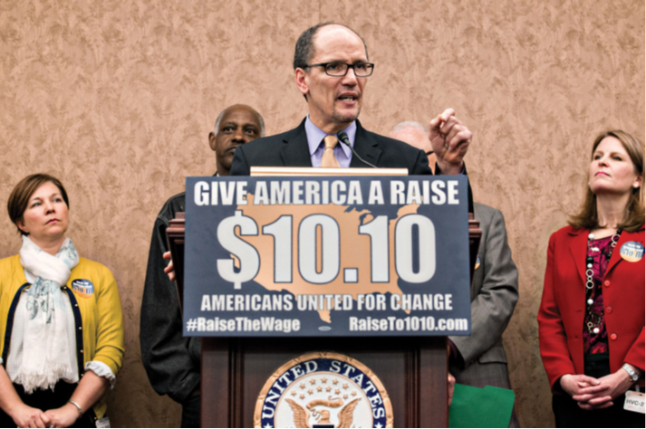
Chapter Outline and Learning Objectives
6.1 Explain how rent ceilings create housing shortages Explain the influences on demand
6.2 Explain how minimum wage laws create unemployment
6.3 Explain the effects of a tax
6.4 Explain the effects of production quotas and subsidies
6.5 Explain how markets for illegal goods work
Notes:
Notes and teaching tips: 5, 9, 16, 17, 18, 34, 46, and 47.
To advance to the next slide, click anywhere on the full screen figure.
Applying the principles of economics to interpret and understand the news is a major goal of the principles course. You can encourage your students in this activity by using the two features: Economics in the News and Economics in Action.
(1) Before each class, scan the news and select two or three headlines that are relevant to your session today. There is always something that works. Read the headline and ask for comments, interpretation, discussion. Pose questions arising from it that motivate today’s class. At the end of the class, return to the questions and answer them with the tools you’ve been explaining.
(2) Once or twice a semester, set an assignment, for credit, with the following instructions:
(a) Find a news article about an economic topic that you find interesting.
(b) Make a short bullet-list summary of the article.
(c) Write and illustrate with appropriate graphs an economic analysis of the key points in the article.
Use the Economics in the News features in your textbook as models.

Slide 3
A Housing Market with a Rent Ceiling (1 of 10)
A price ceiling or price cap is a regulation that makes it illegal to charge a price higher than a specified level.
When a price ceiling is applied to a housing market it is called a rent ceiling.
If the rent ceiling is set above the equilibrium rent, it has no effect. The market works as if there were no ceiling.
But a rent ceiling set below the equilibrium rent creates
A housing shortage
Increased search activity
A black market

Slide 4
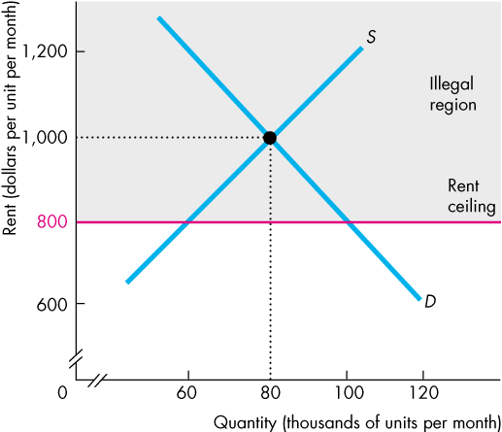
A Housing Market with a Rent Ceiling (2 of 10)
Housing Shortage
Figure 6.1 shows the effects of a rent ceiling that is set below the equilibrium rent.
The equilibrium rent is $1,000 a month.
A rent ceiling is set at $800 a month.
So the equilibrium rent is in the illegal region.

Slide 5
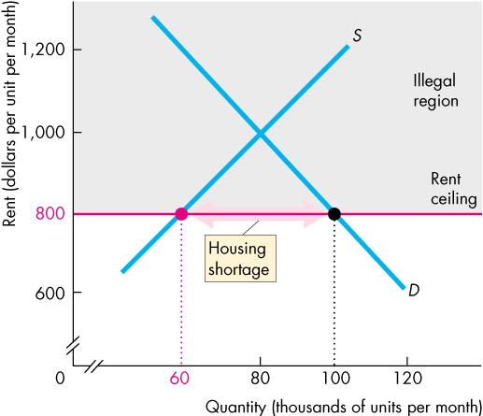
A Housing Market with a Rent Ceiling (3 of 10)
At the rent ceiling, the quantity of housing demanded exceeds the quantity supplied.
There is a shortage of housing.
Notes:
Explain that because landlords can’t be forced to supply a greater quantity than they wish, the quantity of housing supplied at the rent ceiling is less than the quantity that would be supplied in an unregulated market.

Slide 6
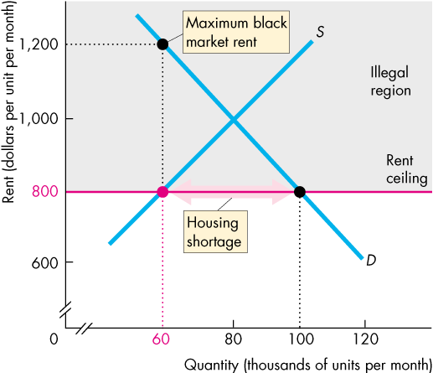
A Housing Market with a Rent Ceiling (4 of 10)
Because the legal price cannot eliminate the shortage, other mechanisms operate:
Increased search activity
A black market
With the shortage, someone is willing to pay up to $1,200 a month.

Slide 7
A Housing Market with a Rent Ceiling (5 of 10)
Increased Search Activity
The time spent looking for someone with whom to do business is called search activity.
When a price is regulated and there is a shortage, search activity increases.
Search activity is costly and the opportunity cost of housing equals its rent (regulated) plus the opportunity cost of the search activity (unregulated).
Because the quantity of housing is less than the quantity in an unregulated market, the opportunity cost of housing exceeds the unregulated rent.

Slide 8
A Housing Market with a Rent Ceiling (6 of 10)
A Black Market
A black market is an illegal market that operates alongside a legal market in which a price ceiling or other restriction has been imposed.
A shortage of housing creates a black market in housing.
Illegal arrangements are made between renters and landlords at rents above the rent ceiling—and generally above what the rent would have been in an unregulated market.

Slide 9
A Housing Market with a Rent Ceiling (7 of 10)
Inefficiency of a Rent Ceiling
A rent ceiling set below the equilibrium rent leads to an inefficient underproduction of housing services.
The marginal social benefit from housing services exceeds its marginal social cost and a deadweight loss arises.
Figure 6.2 illustrates this inefficiency.
Notes:
Classroom activity
Check out Economics in Action: Rent Control Winners: The Rich and Famous

Slide 10
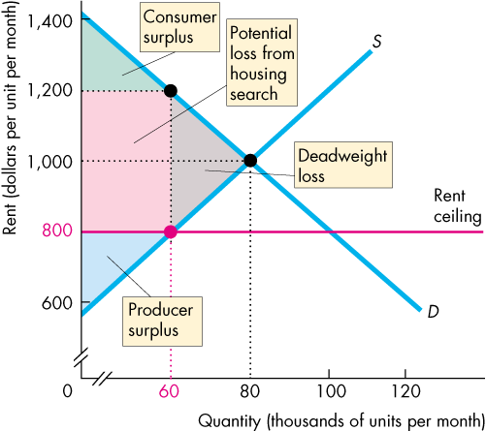
A Housing Market with a Rent Ceiling (8 of 10)
A rent ceiling decreases the quantity of housing supplied to less than the efficient quantity.
A deadweight loss arises.
Producer surplus shrinks.
Consumer surplus shrinks.
There is a potential loss from increased search activity.

Slide 11
A Housing Market with a Rent Ceiling (9 of 10)
Are Rent Ceilings Fair?
According to the fair rules view, a rent ceiling is unfair because it blocks voluntary exchange.
According to the fair results view, a rent ceiling is unfair because it does not generally benefit the poor.
A rent ceiling decreases the quantity of housing and the scarce housing is allocated by
Lottery
First-come, first-served
Discrimination

Slide 12
A Housing Market with a Rent Ceiling (10 of 10)
A lottery gives scarce housing to the lucky.
A first-come, first served gives scarce housing to those who have the greatest foresight and get their names on the list first.
Discrimination gives scarce housing to friends, family members, or those of the selected race or sex.
None of these methods leads to a fair outcome.

Slide 13
A Labor Market with a Minimum Wage (1 of 7)
A price floor is a regulation that makes it illegal to trade at a price lower than a specified level.
When a price floor is applied to labor markets, it is called a minimum wage.
If the minimum wage is set below the equilibrium wage rate, it has no effect. The market works as if there were no minimum wage.
If the minimum wage is set above the equilibrium wage rate, it has powerful effects.

Slide 14
A Labor Market with a Minimum Wage (2 of 7)
Minimum Wage Brings Unemployment
If the minimum wage is set above the equilibrium wage rate, the quantity of labor supplied by workers exceeds the quantity demanded by employers.
There is a surplus of labor.
The quantity of labor hired at the minimum wage is less than the quantity that would be hired in an unregulated labor market.
Because the legal wage rate cannot eliminate the surplus, the minimum wage creates unemployment.

Slide 15
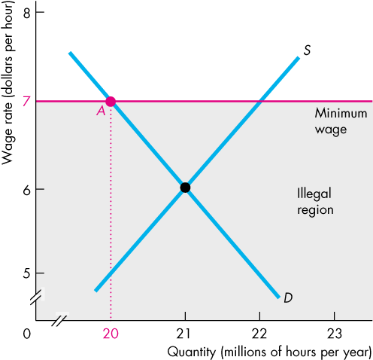
A Labor Market with a Minimum Wage (3 of 7)
The equilibrium wage rate is $6 an hour.
The minimum wage rate is set at $7 an hour.
So the equilibrium wage rate is in the illegal region.
The quantity of labor employed is the quantity demanded.

Slide 16
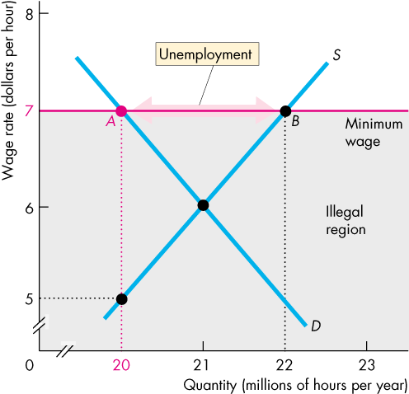
A Labor Market with a Minimum Wage (4 of 7)
The quantity of labor supplied exceeds the quantity demanded and unemployment is created.
With only 20 million hours demanded, some workers are willing to supply the last hour demanded for $5.
Notes:
Classroom activity
Check out Economics in the News: Push to Raise the Minimum Wage

Slide 17
A Labor Market with a Minimum Wage (5 of 7)
Is the Minimum Wage Fair?
A minimum wage rate in the United States is set by the federal government’s Fair Labor Standards Act.
In 2009, the federal minimum wage rate was raised to $7.25 an hour and has remained at $7.25 an hour through 2014.
Some state governments have set minimum wages above the federal minimum wage rate.
Most economists believe that minimum wage laws increase the unemployment rate of low-skilled younger workers.
Notes:
Talk about the study of wage and employment data by David Card and Alan Krueger (Myth and Measurement: The New Economics of the Minimum Wage Law, Princeton: Princeton University Press, 1995), which suggests that minimum wage laws do not cause unemployment.
Note that other economists disagree and claim that ceteris paribus conditions were violated regarding: the timing of hiring decisions and regional differences.

Slide 18
A Labor Market with a Minimum Wage (6 of 7)
Inefficiency of a Minimum Wage
A minimum wage leads to an inefficient outcome.
The quantity of labor employed is less than the efficient quantity.
The supply of labor measures the marginal social cost of labor to workers (leisure forgone).
The demand for labor measures the marginal social benefit from labor (value of goods produced).
Figure 6.4 illustrates this inefficient outcome.
Notes:
Classroom activity
Check out At Issue: Does the Minimum Wage Cause Unemployment?

Slide 19
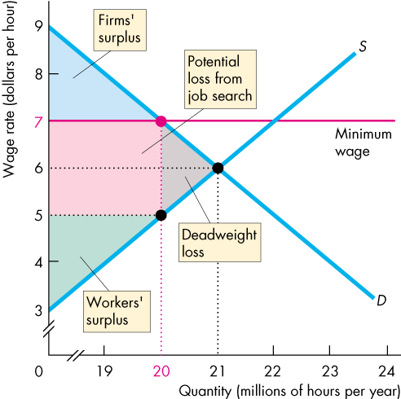
A Labor Market with a Minimum Wage (7 of 7)
A minimum wage set above the equilibrium wage decreases the quantity of labor employed.
A deadweight loss arises.
The potential loss from increased job search decreases both workers’ surplus and firms’ surplus.
The full loss is the sum of the red and gray areas.

Slide 20
Taxes (1 of 21)
Everything you earn and most things you buy are taxed.
Who really pays these taxes?
Income tax and the Social Security tax are deducted from your pay, and state sales tax is added to the price of the things you buy, so isn’t it obvious that you pay these taxes?
Isn’t it equally obvious that your employer pays the employer’s contribution to the Social Security tax?
You’re going to discover that it isn’t obvious who pays a tax and that lawmakers don’t decide who will pay!

Slide 21
Taxes (2 of 21)
Tax Incidence
Tax incidence is the division of the burden of a tax between buyers and sellers.
When an item is taxed, its price might rise by the full amount of the tax, by a lesser amount, or not at all.
If the price rises by the full amount of the tax, buyers pay the tax.
If the price rises by a lesser amount than the tax, buyers and sellers share the burden of the tax.
If the price doesn’t rise at all, sellers pay the tax.

Slide 22
Taxes (3 of 21)
Tax incidence doesn’t depend on tax law!
The law might impose a tax on buyers or sellers, but the outcome will be the same.
To see why, we look at the tax on cigarettes in New York City.
On July 1, 2002, New York City raised the tax on the sales of cigarettes from almost nothing to $1.50 a pack.
What are the effects of this tax?

Slide 23
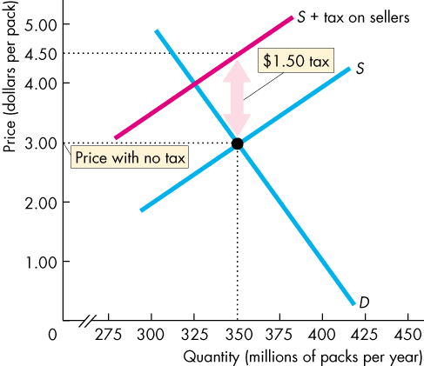
Taxes (4 of 21)
A Tax on Sellers
Figure 6.5 shows the effects of this tax.
With no tax, the equilibrium price is $3.00 a pack.
A tax on sellers of $1.50 a pack is introduced.
Supply decreases and the curve S + tax on sellers shows the new supply curve.

Slide 24
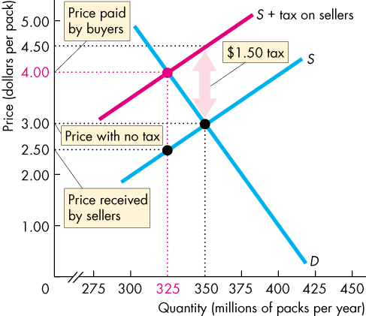
Taxes (5 of 21)
The market price paid by buyers rises to $4.00 a pack and the quantity bought decreases.
The price received by the sellers falls to $2.50 a pack.
So with the tax of $1.50 a pack, buyers pay $1.00 a pack more and sellers receive 50¢ a pack less.

Slide 25
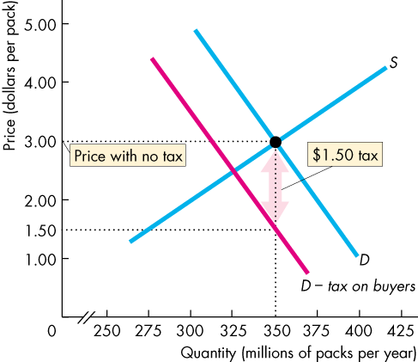
Taxes (6 of 21)
A Tax on Buyers
Again, with no tax, the equilibrium price is $3.00 a pack.
A tax on buyers of $1.50 a pack is introduced.
Demand decreases and the curve D − tax on buyers shows the new demand curve.

Slide 26
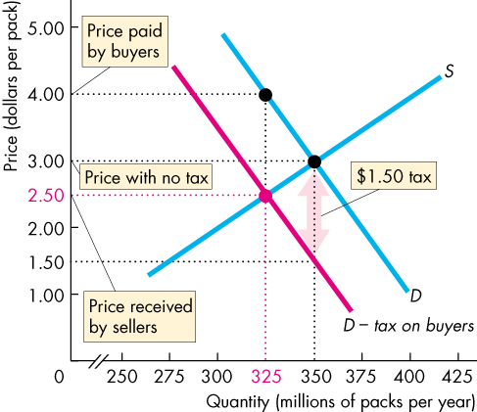
Taxes (7 of 21)
The price received by sellers falls to $2.50 a pack and the quantity decreases.
The price paid by buyers rises to $4.00 a pack.
So with the tax of $1.50 a pack, buyers pay $1.00 a pack more and sellers receive 50¢ a pack less.

Slide 27
Taxes (8 of 21)
Equivalence of Tax on Buyers and Sellers
So, exactly as before when sellers were taxed:
Buyers pay $1.00 of the tax.
Sellers pay the other 50¢ of the tax.
Tax incidence is the same regardless of whether the law says sellers pay or buyers pay.

Slide 28
Taxes (9 of 21)
Tax Incidence and Elasticity of Demand
The division of the tax between buyers and sellers depends on the elasticities of demand and supply.
To see how, we look at two extreme cases.
Perfectly inelastic demand: Buyers pay the entire tax.
Perfectly elastic demand: Sellers pay the entire tax.
The more inelastic the demand, the larger is the buyers’ share of the tax.

Slide 29
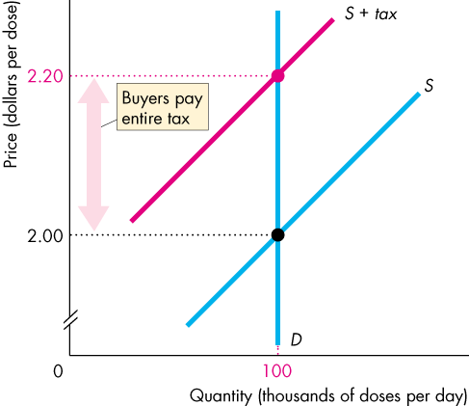
Taxes (10 of 21)
Perfectly Inelastic Demand
Demand for this good is perfectly inelastic—the demand curve is vertical.
When a tax is imposed on this good, buyers pay the entire tax.

Slide 30
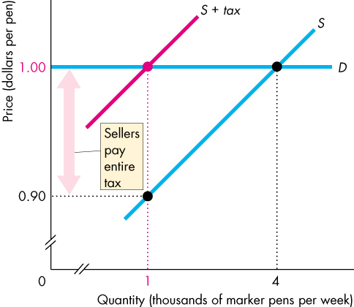
Taxes (11 of 21)
Perfectly Elastic Demand
The demand for this good is perfectly elastic—the demand curve is horizontal.
When a tax is imposed on this good, sellers pay the entire tax.

Slide 31
Taxes (12 of 21)
Tax Incidence and Elasticity of Supply
To see the effect of the elasticity of supply on the division of the tax payment, we again look at two extreme cases.
Perfectly inelastic supply: Sellers pay the entire tax.
Perfectly elastic supply: Buyers pay the entire tax.
The more elastic the supply, the larger is the buyers’ share of the tax.

Slide 32
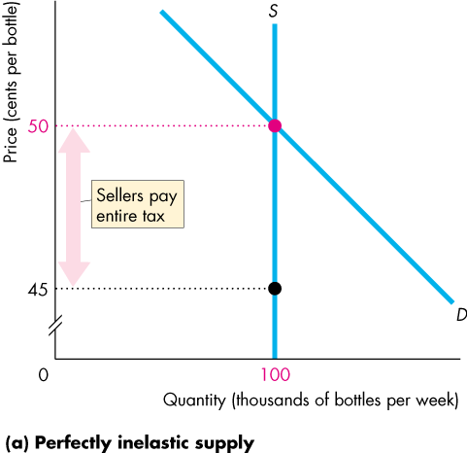
Taxes (13 of 21)
Perfectly Inelastic Supply
The supply of this good is perfectly inelastic—the supply curve is vertical.
When a tax is imposed on this good, sellers pay the entire tax.

Slide 33
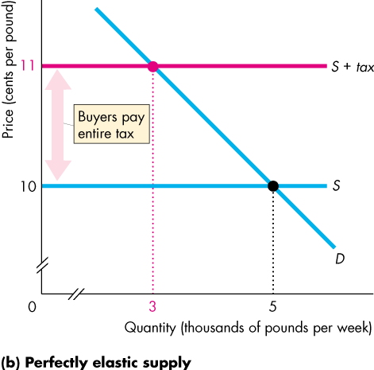
Taxes (14 of 21)
Perfectly Elastic Supply
The supply of this good is perfectly elastic—the supply curve is horizontal.
When a tax is imposed on this good, buyers pay the entire tax.

Slide 34
Taxes (15 of 21)
Taxes in Practice
Taxes usually are levied on goods and services with an inelastic demand or an inelastic supply.
Alcohol, tobacco, and gasoline have inelastic demand, so the buyers of these items pay most of the tax on them.
Labor has a low elasticity of supply, so the seller—the worker—pays most of the income tax and most of the Social Security tax.
Notes:
Taxes and the inelasticity of “sinful” acts. If students understand the basics of taxes, they will become more informed citizen voters. Raise a number of provocative issues related to taxation to evoke student interest in understanding why some goods are taxed and others are not.
Taxing the consumer surplus of smokers—“Once, Twice . . . Three times a levy.” Provoke the students’ interest in tax policy by showing them how cigarette smokers are “taxed” at least three times for their habit:
Many believe that cigarette smoking is considered to be one of the most addictive, legally available products in the market without a doctor’s prescription. The government recognizes demand for cigarettes is highly inelastic and places a hefty sales tax on each pack of cigarettes. Strike one.
Many governments have sued the major tobacco companies for compensation for past and future healthcare costs arising from the smoking-related illnesses of its citizens. Tobacco companies have recently settled these suits by paying hundreds of billions of dollars in penalties. Students should see that inelastic demand for cigarettes allows tobacco producers to pass on most of these costs to the smoker. (This could explain why the settlement has done little in the long run to depress the stock prices and dividends from these major tobacco companies, relative to the whole market.) Strike two.
Due to the increased health risk of smoking, the average smoker dies at a much earlier age than the average non-smoker. This means that smokers can expect to receive little, if any, return on all the Social Security taxes they’ve been paying in throughout their lives. (That is, assuming any of us will get anything back for our Social Security taxes!) Strike three!
Classroom activity
Check out Economics in Action: Workers and Consumers Pay the Most Tax

Slide 35
Taxes (16 of 21)
Taxes and Efficiency
Except in the extreme cases of perfectly inelastic demand or perfectly inelastic supply when the quantity remains the same, imposing a tax creates inefficiency.
Figure 6.10 shows the inefficiency created by a $20 tax on MP3 players.

Slide 36
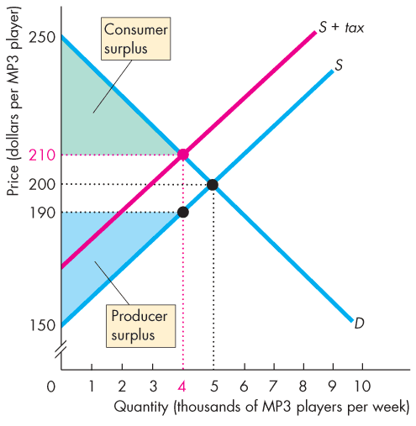
Taxes (17 of 21)
With no tax, marginal social benefit equals marginal social cost.
Total surplus (the sum of consumer surplus and producer surplus) is maximized.
The market is efficient.
The tax decreases the quantity, raises the buyers’ price, and lowers the sellers’ price.

Slide 37
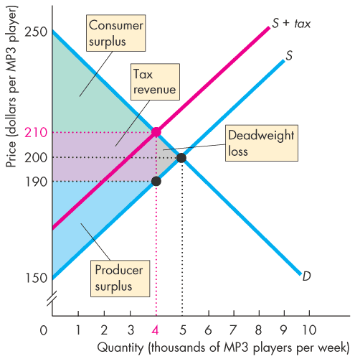
Taxes (18 of 21)
Marginal social benefit exceeds marginal social cost and the tax is inefficient.
The tax revenue takes part of the total surplus.
The decreased quantity creates a deadweight loss.

Slide 38
Taxes (19 of 21)
Taxes and Fairness
Economists propose two conflicting principles of fairness to apply to a tax system:
The benefits principle
The ability-to-pay principle

Slide 39
Taxes (20 of 21)
The Benefits Principle
The benefits principle is the proposition that people should pay taxes equal to the benefits they receive from the services provided by government.
This arrangement is fair because it means that those who benefit most pay the most taxes.

Slide 40
Taxes (21 of 21)
The Ability-to-Pay Principle
The ability-to-pay principle is the proposition that people should pay taxes according to how easily they can bear the burden of the tax.
A rich person can more easily bear the burden than a poor person can.
So the ability-to-pay principle can reinforce the benefits principle to justify high rates of income tax on high incomes.

Slide 41
Production Quotas and Subsidies (1 of 6)
Intervention in markets for farm products takes two main forms:
Production quotas
Subsidies
A production quota is an upper limit to the quantity of a good that may be produced during a specified period.
A subsidy is a payment made by the government to a producer.

Slide 42
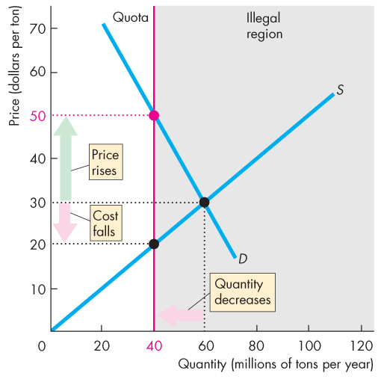
Production Quotas and Subsidies (2 of 6)
Production Quotas
With no quota, the price is $30 a ton and 60 million tons a year are produced.
With the production quota of 40 million tons a year, quantity decreases to 40 million tons a year.
The market price rises to $50 a ton and marginal cost falls to $20 a ton.

Slide 43
Production Quotas and Subsidies (3 of 6)
Inefficiency
At the quantity produced:
Marginal social benefit equals the market price, which has increased.
Marginal social cost has decreased.
Production is inefficient and producers have an incentive to cheat.

Slide 44
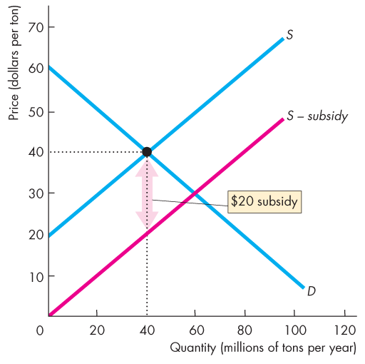
Production Quotas and Subsidies (4 of 6)
Subsidies
With no subsidy, the price is $40 a ton and 40 million tons a year are produced.
With a subsidy of $20 a ton, marginal cost minus subsidy falls by $20 a ton and the new supply curve is S – subsidy.

Slide 45
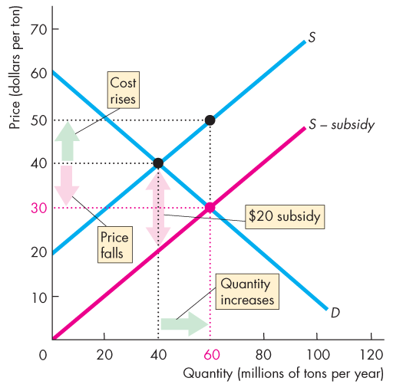
Production Quotas and Subsidies (5 of 6)
The market price falls to $30 a ton and farmers increase the quantity to 60 million tons a year.
But farmers’ marginal cost increases to $50 a ton.
With the subsidy, farmers receive more on each ton sold—the price of $30 a ton plus the subsidy of $20 a ton, which is $50 a ton.

Slide 46
Production Quotas and Subsidies (6 of 6)
Inefficient Overproduction
At the quantity produced:
Marginal social benefit equals the market price, which has fallen.
Marginal social cost has increased and exceeds marginal social benefit.

Slide 47
Markets for Illegal Goods (1 of 8)
The U.S. government prohibits trade of some goods, such as illegal drugs.
Yet, markets exist for illegal goods and services.
How does the market for an illegal good work?
To see how the market for an illegal good works, we begin by looking at a free market and see the changes that occur when the good is made illegal.
Notes:
Students are always interested in this analysis. The major thing to achieve is an awareness that declaring an activity to be illegal must be backed up with incentives—penalties. And taxes can work as an alternative incentive to achieve an identical outcome in terms of price and quantity.
This analysis is another good place to emphasize that the opportunity cost of something is the market price plus any other costs of buying.

Slide 48
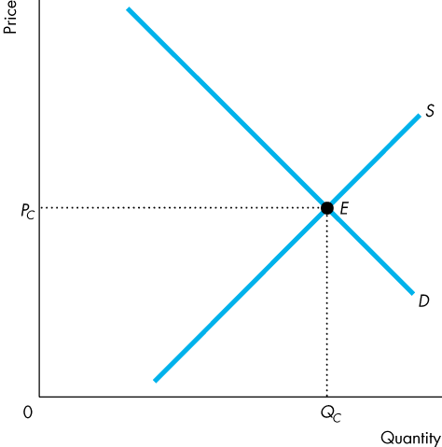
Markets for Illegal Goods (2 of 8)
A Free Market for a Drug
Figure 6.13 shows the market for a drug such as marijuana.
Market equilibrium is at point E.
The price is P_{C} and the quantity is Q_{C}.

Slide 49
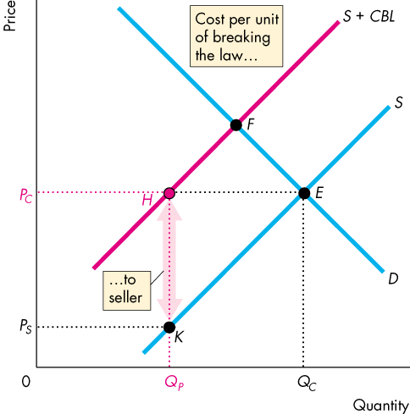
Markets for Illegal Goods (3 of 8)
Penalties on Sellers
If the penalty on the seller is the amount HK, then the quantity supplied at a market price of P_{C} is Q_{P}.
Supply of the drug decreases to S + CBL.
The new equilibrium is at point F. The price rises and the quantity decreases.

Slide 50
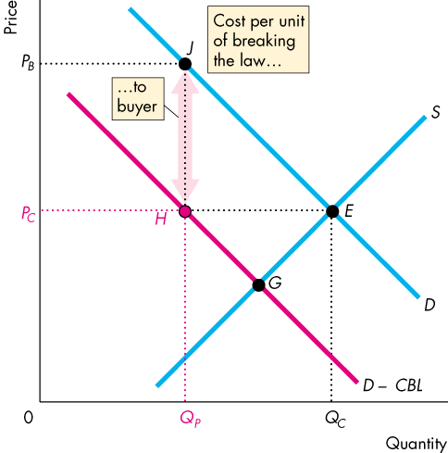
Markets for Illegal Goods (4 of 8)
Penalties on Buyers
If the penalty on the buyer is the amount JH, the quantity demanded at a market price of P_{C} is Q_{P}.
Demand for the drug decreases to D – CBL.
The new equilibrium is at point G. The market price falls and the quantity decreases.

Slide 51
Markets for Illegal Goods (5 of 8)
But the opportunity cost of buying this illegal good rises above P_{C} because
the buyer pays the market price plus the cost of breaking the law.

Slide 52
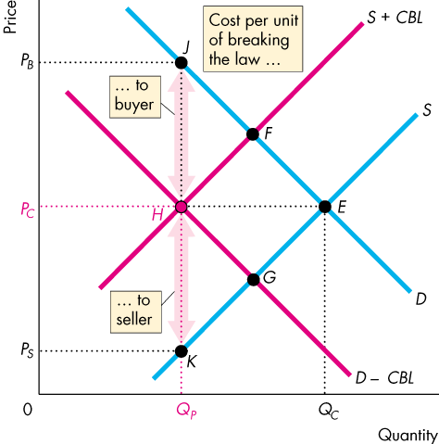
Markets for Illegal Goods (6 of 8)
Penalties on Both Sellers and Buyers
With both sellers and buyers penalized for trading in the illegal drug, …
both the demand for the drug and the supply of the drug decrease.

Slide 53
Markets for Illegal Goods (7 of 8)
The new equilibrium is at point H.
The quantity decreases to Q_{P}.
The market price is P_{C}.
The buyer pays P_{B} and the seller receives P_{S}.

Slide 54
Markets for Illegal Goods (8 of 8)
Legalizing and Taxing Drugs
An illegal good can be legalized and taxed.
A high enough tax rate would decrease consumption to the level that occurs when trade is illegal.
Arguments that extend beyond economics surround this choice.

